Slide 1
Module 3-Mechanics
Conservative and Non conservative forces
Motion in gravitational field

Slide 2
Work is the energy transferred to or from an object via the application of force along a displacement. In its simplest form, it is often represented as the product of force and displacement.
A force is said to do positive work if (when applied) it has a component in the direction of the displacement of the point of application. A force does negative work if it has a component opposite to the direction of the displacement at the point of application of the force.
For example, when a ball is held above the ground and then dropped, the work done by the gravitational force on the ball as it falls is equal to the weight of the ball (a force ‘F’) multiplied by the distance to the ground (a displacement ‘S’). When the force F is constant and the angle between the force and the displacement s is θ, then the work done is given by:
w = F.S.cos θ
Work is a scalar quantity so it has only magnitude and no direction. Work transfers energy from one place to another, or one form to another. The SI unit of work is the Joule (J), the same unit as for energy.

Slide 3
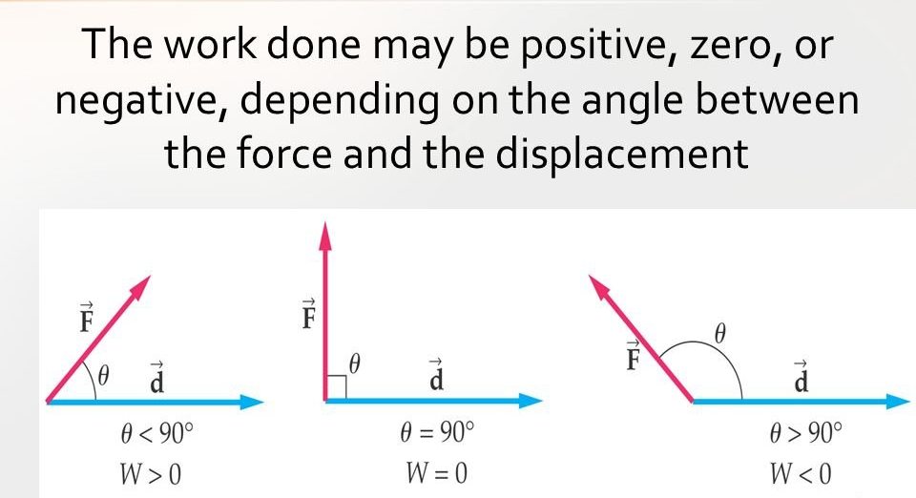
Positive Work : If a force displaces the object in its direction, then the work done is positive. The example of this kind of work done is motion of ball falling towards ground where displacement of ball is in the direction of force of gravity.
2. Negative Work : If the force and the displacement are in opposite directions, then the work is said to be negative. For example if a ball is thrown in upwards direction, its displacement would be in upwards direction but the force due to earths gravity is in the downward direction.
3. Zero Work : If the directions of force and the displacement are perpendicular to each other, the work done by the force on the object is zero.
Reference: https://www.toppr.com/ask/content/concept/nature-of-work-done-208554/

Slide 4
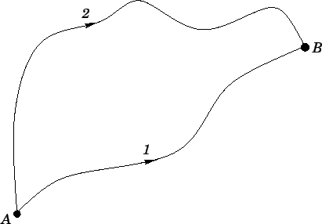


Conservative and non-conservative force-fields
Suppose that a non-uniform force-field f(r) acts upon an object which moves along a curved trajectory,
labelled path 1and path 2 , from point A to B as shown in the figure :
The work done by force field in the two different paths can be given as respectively

Slide 5

There are two possibilities on which the work done depends upon
Might depend on the end points and not on the path
W₁ =W₂
Conservative force field
Might depend on the end points and the path taken as well
W₁≠W₂
Non conservative force field

Slide 6


Suppose, the object moves from point A to B along path 1, and then from point B to A along path 2 what is the total work done on the object by the force-field as it executes this closed circuit?
Therefore along path 2 which is equal to –W₂
It follows that the total work done on the object as it executes the circuit(round trip) is simply

Slide 7
Conservative Force Field
For a conservative force field W₁ = W₂
Hence, we conclude that ΔW=0
In other words, the net work done by a conservative field on an object taken around a closed loop is zero. This is just another way of saying that a conservative field stores energy without loss: i.e., if an object gives up a certain amount of energy to a conservative field in travelling from point A to B, the force field returns it back without loss.
Gravitational field is an example for conservative force field

Slide 8
Trying to understand gravitational force field from the stand point of conservative force field
The work done on an object by the constant gravitational force, near the surface of Earth, over any displacement is a function only of the difference in the positions of the end-points of the displacement. This property allows us to define a different kind of energy for the system than its kinetic energy, which is called potential energy.

Slide 9
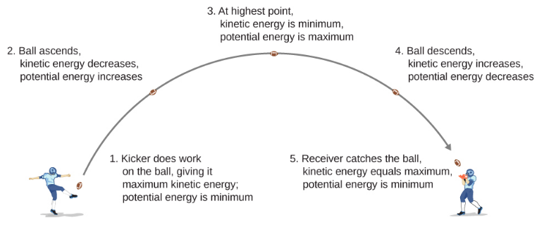
Let us analyze the motion of a projectile, like kicking a football as given in the figure .

Slide 12
Let’s ignore friction and air resistance. As the football rises, the work done by the gravitational force on the football is negative, because the ball’s displacement is positive vertically and the force due to gravity is negative vertically. The ball slows down until it reaches its highest point in the motion, thereby decreasing the ball’s kinetic energy. This loss in kinetic energy translates to a gain in gravitational potential energy of the football-Earth system.
As the football falls toward Earth, the work done on the football is now positive, because the displacement and the gravitational force both point vertically downward. The ball also speeds up, which indicates an increase in kinetic energy. Therefore, energy is converted from gravitational potential energy back into kinetic energy.

Slide 13
Based on this scenario, we can define the difference of potential energy from point A to point B as the negative of the work done:
∆U_{AB} = U_{B} – U_{A} = - W_{AB}
This formula explicitly states a potential energy difference, not just an absolute potential energy. Therefore, we need to define potential energy at a given position in such a way as to state standard values of potential energy on their own, rather than potential energy differences. We do this by rewriting the potential energy function in terms of an arbitrary constant,
∆U = U(r) – U (r_{o})

Slide 14
The choice of the potential energy at a starting location of r₀⃗ is made out of convenience in the given problem. Most importantly, whatever choice is made should be stated and kept consistent throughout the given problem. There are some well-accepted choices of initial potential energy. For example, the lowest height in a problem is usually defined as zero potential energy.
As long as there is no friction or air resistance, the change in kinetic energy of the football equals negative of the change in gravitational potential energy of the football. This can be generalized to any potential energy:
∆K_{AB} = -∆U_{AB}

Slide 15
When comparing the motion of the football in Figure, the total energy of the system never changes, even though the gravitational potential energy of the football increases, as the ball rises relative to ground and falls back to the initial gravitational potential energy when the football player catches the ball. This is the characteristics of a conservative force field, i.e total energy is conserved
Referencs:
Contributors and Attributions:
Samuel J. Ling (Truman State University), Jeff Sanny (Loyola Marymount University), and Bill Moebs with many contributing authors. This work is licensed by OpenStax University Physics under a Creative Commons Attribution License (by 4.0).
https://phys.libretexts.org/Bookshelves/University_Physics/Book%3A_University_Physics_(OpenStax)/Map%3A_University_Physics_I_-_Mechanics_Sound_Oscillations_and_Waves_(OpenStax)/08%3A_Potential_Energy_and_Conservation_of_Energy/8.03%3A_Conservative_and_Non-Conservative_Forces

Slide 16
Compute the work done by the gravitational force for the following cases:
Y
B
Y
B
D
h
h
A
A
C
0
x
0
x
Force F = mg (- j)= -mg j
Displacement dr = dx i + dy j

Slide 17
Work done along path 1:
Work done along path 2:
W1 = ∫ F dr
= ∫ -mg dy
= -mg ∫ dy
= -mgh
W2 = ∫ -mg j .dx i + ∫-mgdy + ∫ -mgj .dx(-i)
W2 = -mgh

Slide 18
Non conservative force field
In the case of a non-conservative field, since W₁ is not equal to W₂
∆W ≠ 0
In other words, the net work done by a non-conservative field on an object taken around a closed loop is non-zero. In practice, the net work is invariably negative. This is just another way of saying that a non-conservative field dissipates energy: i.e., if an object gives up a certain amount of energy to a non-conservative field in travelling from point A to point B, then the field only returns part, or, perhaps, none, of this energy to the object when it travels back to point B. The remainder is usually dissipated as heat.

Slide 19
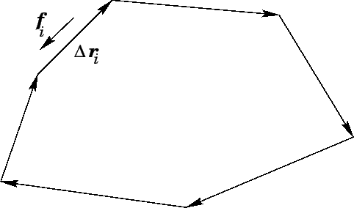
A typical example of a non-conservative field might consist of an object moving over a rough horizontal surface. Suppose, for the sake of simplicity, that the object executes a closed circuit on the surface which is made up entirely of straight-line segments, as shown in Figure

Slide 20

Let Δr_{i} represent the vector displacement of the i^{th} leg of this circuit. Suppose that the frictional force acting on the object as it executes this leg is f_{i}. One thing that we know about a frictional force is that it is always directed in the opposite direction to the instantaneous direction of motion of the object upon which it acts.
Thus, the net work performed by the frictional force on the object,
as it executes the circuit, is given by

Slide 21
The fact that the net work is negative indicates that the frictional force continually drains energy from the object as it moves over the surface.
This energy is actually dissipated as heat and is, therefore, lost to the environment. (Generally speaking, the laws of thermodynamics forbid energy which has been converted into heat from being converted back to its original form.) Hence, friction is an example of a non-conservative force, because it dissipates energy rather than storing it.
Reference:
http://farside.ph.utexas.edu/teaching/301/lectures/node59.html
https://cnx.org/contents/1AJmkLE0@2.9:pr8nEN9R@3/Projection-in-gravitational-field

Slide 22
Consider an object of mass 2 kg moved by an external force 20 N in a surface having coefficient of kinetic friction 0.9 to a distance 10 m. What is the work done by the external force and kinetic friction ? Comment on the result.
Work done by external force:
Work done by kinetic frictional force:
WE = 20 x 10
= 200 J
Fr = 18 N= μ (mg)
WFR = -18 x 10 = -180 J

Slide 23
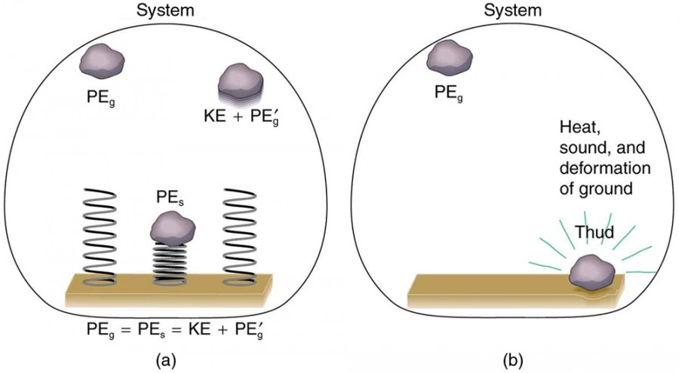
Figure shows comparison of the effects of conservative and non conservative forces on the mechanical energy of a system. (a) A system with only conservative forces. When a rock is dropped onto a spring, its mechanical energy remains constant (neglecting air resistance) because the force in the spring is conservative. The spring can propel the rock back to its original height, where it once again has only potential energy due to gravity. (b) A system with non conservative forces. When the same rock is dropped onto the ground, it is stopped by non conservative forces that dissipate its mechanical energy as thermal energy, sound, and surface distortion. The rock has lost mechanical energy.

Slide 24
Motion in Gravitational Field
Gravitational force of attraction is a binding force. An object requires certain minimum velocity to break free from this attraction. We are required to impart object with certain kinetic energy to enable it to overcome gravitational pull. As the object moves away, gravitational pull becomes smaller. However, at the same time, speed of the object gets reduced as kinetic energy of the object is continuously transferred into potential energy. Remember, potential energy is maximum at the infinity. Depending on the initial kinetic energy imparted to the projectile, it will either return to the surface or will move out of the Earth’s gravitational field.
The motion of a projectile
Away from Earth’s surface, g is not a constant
Near Earth’s surface, g is a constant
Equations of motion can be used to analyze situations as well as techniques based on conservation of energy will also be useful
Equations of motion can not be used to analyze situations and only techniques based on conservation of energy will be useful

Slide 25
Context of Motion
Air resistance i.e. friction and gravitational force are the two forces to be considered for projectile : .Air resistance is an external non-conservative force, whereas gravity is an internal conservative force to the "Earth-projectile" system.
Air resistance is neglected for mathematical derivation. This is a base consideration for understanding motion of an object in a gravitational field at greater distances. Actual motion will not be same as air resistance at higher velocity generates tremendous heat and the projectile, as a matter of fact, will either burn up or will not reach the distances as predicted by the analysis. Hence, this is the limitation of the analysis.
Since, the only force considered is gravity law of conservation of energy can be applied to analyse the situation. There is only conservative force in operation on the object in translation. The immediate consequence is that work by this force is independent of path. As there is no external force on the system, the changes takes place between potential and kinetic energy in such a manner that overall change in mechanical energy always remains zero. In other words, only transfer of energy between kinetic and gravitational potential energy takes place.
That means ∆KE + ∆PE = ∆TE =0

Slide 26
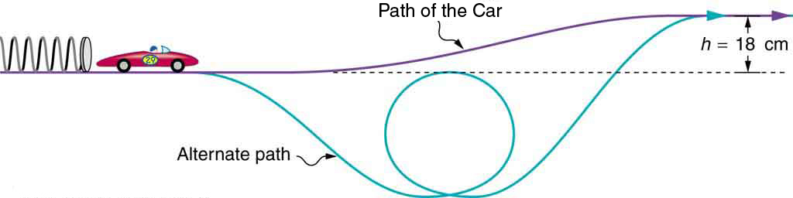
.A 0.100-kg toy car is propelled by a compressed spring, as shown in Figure 3. The car follows a track that rises 0.180 m above the starting point. The spring is compressed 4.00 cm and has a force constant of 250.0 N/m. Assuming work done by friction to be negligible, find the following:
1. How fast is the car going before it starts up the slope?
2. How fast is it going at the top of the slope?

Slide 27
The spring force and the gravitational force are conservative forces, so conservation of mechanical energy can be used. Thus,
KE_{i} + PE_{i} = KE_{f} + Pe_{f}
½ kx_{i} ² + ½ mv_{i}² + mgh_{i} = ½ mv_{f}² + mgh_{f}+ 1/2 kx_{f}²
Deconstructing the problem:
The compression to 4 cm in the spring is the x_{i} value and the spring coming back to its equilibrium position i.e 0 is its x_{f} value.
When the spring is compressed, the elastic potential energy is maximum in the spring and elastic kinetic energy is zero.
When the spring is released, at the x_{f} position this potential energy is completely converted as the initial kinetic energy of the car i.e½ mv_{i}².
The car moves with this initial speed and when it ramps up this a part of this energy is lost to the gravitational field which in turn is given back to the object by the gravitational field in the form of gravitational potential energy.
When the car reaches the maximum height, the gravitational potential energy is maximum and kinetic energy is minimum

Slide 28
1.How fast is the car going before it starts up the slope?
Velocity of the car before it starts climbing up
½ kx_{i}² = 1/2 mv_{f}²
V_{f} = ((250 x (4x10⁻²)²)/ 0.1)^{1/2}
= 2 m/s
2.How fast is it going at the top of the slope?
1/2mv_{i}² = 1/2mv_{f}² + mgh
½ m (v_{i}²- v_{f}²) = mgh
v_{f}= (v_{i}² – 2gh)^{1/2}
= (4- 3.528)^{1/2}
v_{f}=0.687 m/s

Slide 29
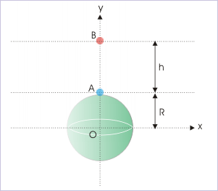
The expression “mgh” was used to compute potential energy or change in potential energy. This has to be corrected to determining change in potential energy by referring calculation of potential energy to infinity. Using formula of potential energy with infinity as reference, we determine the potential difference between Earth’s surface and a point above it, as

Slide 30
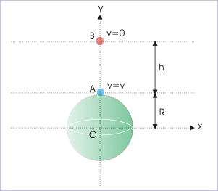
Considering, variable acceleration by applying conservation of mechanical energy with reference to a large distance.
K_{i} + U_{i} = K_{f} + U_{f}
½ mv² –GMm/R = 0 – GMm/(R+H)
This is the maximum height attained by a projection, which is thrown up from the surface of Earth, can be derived and is equal to
h = v²/(2g-(v²/R))
Escape velocity can be derived using
K_{i} + U_{i} = K_{f} + U_{f}
i.e.,
½ mu² –GMm/R = 1/2mv² – GMm/(R+H)
V_{e} =(2gR)^{1/2}
= 11.2 km/s

Slide 31
A particle is projected vertically at 5 km/s from the surface Earth. Find the
maximum height attained by the particle. Given, radius of Earth = 6400 km and
g = 10 m/s^{2.}
Varying acceleration:
Constant acceleration:
h= V²/2g
= 1250 km
h = v²/(2g-(v²/R))
= 1550 km

